Slide 1
Using authority vocabularies HKCAN and LCNAMES simultaneously
Yoel Kortick
Senior Librarian

Slide 2



Introduction
Order of multiple vocabularies being used
Configuration
An example
The results

Slide 3
Introduction
This presentation will show how it is possible to use the following two vocabularies simultaneously:
Hong Kong Chinese Authority (Name) (HKCAN)
Browsable here
Library of Congress Names
Browsable here

Slide 4
Order of multiple vocabularies being used

Slide 5
Order of multiple vocabularies being used
One name might exist in two used authority files. Therefore we will need to determine the order of which authority file to "use" first and which to "use" second.
When we say here "use" we mean "look for a match"
For example, name "$$a Mao, Zedong, $$d 1893-1976" exists in both HKCAN and LCNAMES.
If "$$a Mao, Zedong, $$d 1893-1976" is in a bibliographic record name field such as 100 or 700 we need to determine which authority vocabulary will be "used": HKCAN or LCNAMES?

Slide 6
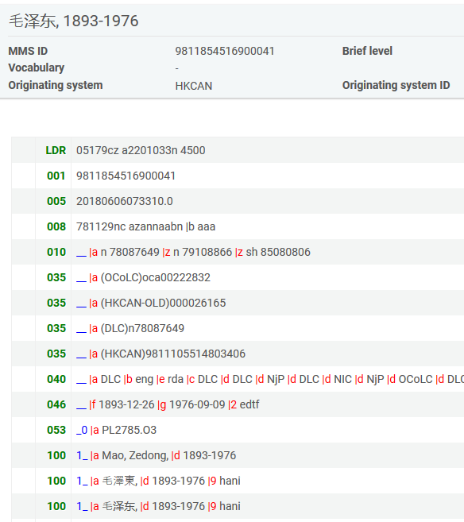
Order of multiple vocabularies being used
$$a Mao, Zedong, $$d 1893-1976 HKCAN

Slide 7
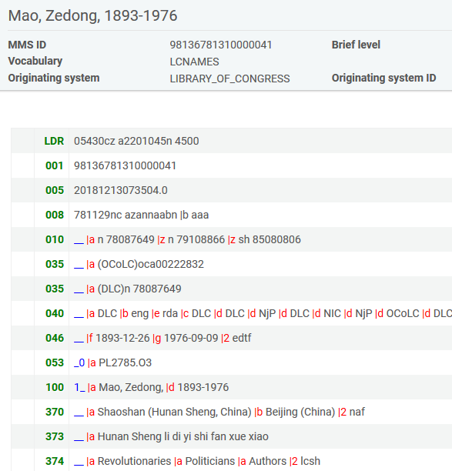
Order of multiple vocabularies being used
$$a Mao, Zedong, $$d 1893-1976 LCNAMES

Slide 8
Configuration

Slide 9
Configuration
Now we will define two parameters:
authority_names = HKCAN,LCNAMES
temp_enable_linking_without_language = true
Note that these parameters are defined by Ex Libris.
The definitions in these parameters are typically made during migration and implementation.
If it is desired to change this at another stage then the library should submit a Sales Force case and Ex Libris will make the change.

Slide 10
Configuration
Below in the parameter authority_names it is defined that both HKCAN and LCNAMES will be used for the names authority file and that HKCAN will be used first

Slide 11
Configuration
Below in the parameter temp_enable_linking_without_language it is defined true meaning that it is not necessary to put a language code in the bibliographic heading when matching to an HKCAN heading even though HKCAN is a multilingual authority.

Slide 12
An example

Slide 13
An example
We are now editing MMSID 991002015549705076 title "The French women don't get fat cookbook / Mireille Guiliano."
We add these three fields:
7001_ $$a Peng, Lishan, $$d 1922-2015
7001_ $$a Steinem, Gloria
7001_ $$a Mao, Zedong $$d 1893-1976

Slide 14
An example
7001_ $$a Peng, Lishan, $$d 1922-2015
exists in HKCAN as a non preferred term of $$a Yu, Pengnian, $$d 1922-2015. Does not exist in LCNAMES
We expect it to match the non preferred term in HKCAN (because it is first in the list and anyway it does not exist in LCNAMES) and then flip to the preferred term when the job Authorities - Preferred Term Correction runs
7001_ $$a Steinem, Gloria
exists in LCNAMES as a preferred term. Does not exist in HKCAN.
We expect it to match the preferred term in LCNAMES (because it does not exist in HKCAN)
7001_ $$a Mao, Zedong $$d 1893-1976
Exists in both HKCAN and LCNAMES
We expect it to match the preferred term in HKCAN (because even though it exists in both we defined to "use" HKCAN first in the list).

Slide 15
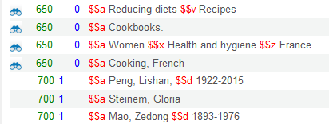
An example
Here are the fields before saving the record

Slide 16
The results

Slide 17
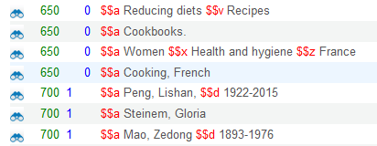
The results
Here are the fields after saving the record.
We did not do F3, we just save the record
All headings link to an authority record
They all matched authority records

Slide 18
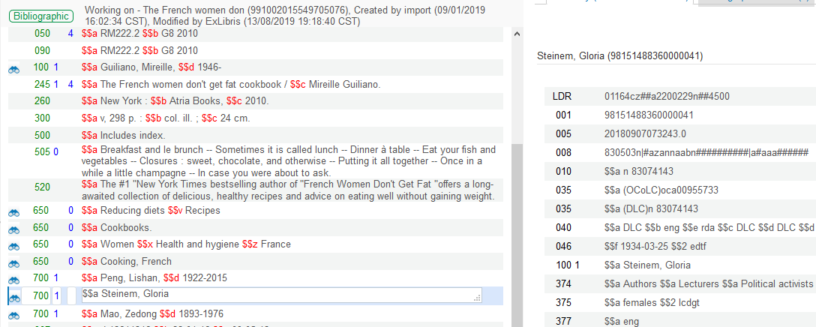
The results
Gloria Steinem matched the LCNAMES record

Slide 19
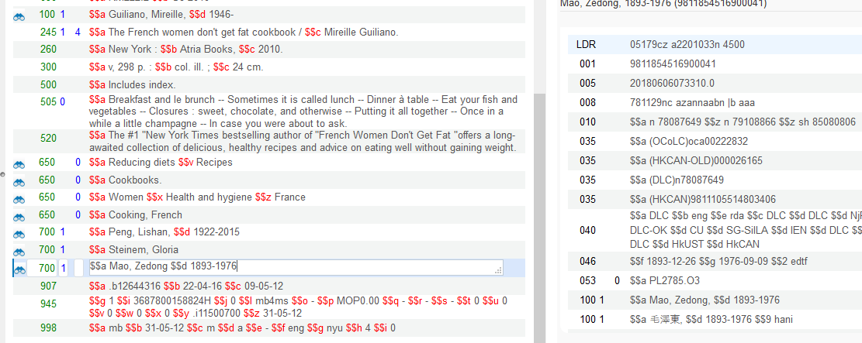
The results
Mao, Zedung, 1893-1976 match the HKCAN record and not the LCNAMES record

Slide 20
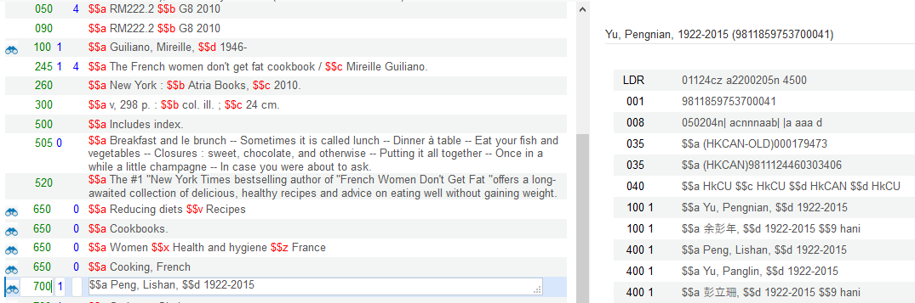
The results
Peng, Lishan, 1922-2015 matched the HKCAN non preferred heading

Slide 21
The results
The non-preferred HKCAN heading "Peng, Lishan, 1922-2015" will change to the preferred heading "Yu, Pengnian, 1922-2015" when the job "Authorities Preferred Term Correction" runs.
Saving the record links the bibliographic heading to the authority heading.
The job "Authorities Preferred Term Correction" changes non-preferred terms to preferred terms.

Slide 22
The results
Make sure that the parameter disable_preferred_term_correction_job at "Configuration > Resources > general > Other Settings" is set to "false" so that the job "Authorities Preferred Term Correction" will successfully update headings

Slide 23
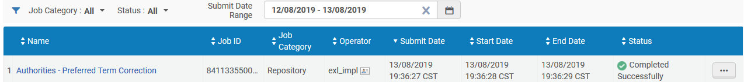
The results
The job "Authorities Preferred Term Correction" runs

Slide 24
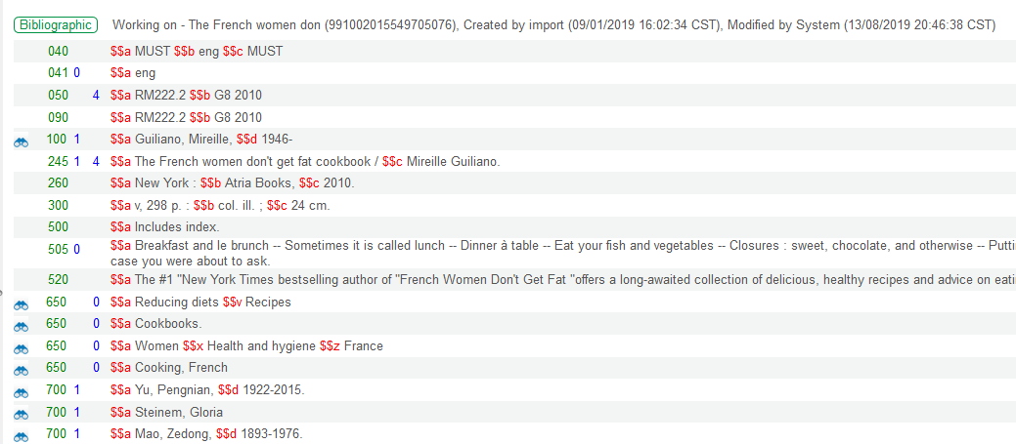
The results
The non preferred HKCAN linked heading $$a "Peng, Lishan, $$d 1922-2015" changes to the HKCAN preferred term heading "$$a Yu, Pengnian, $$d 1922-2015"
Record modified by "System" which is the "Preferred Term Correction Job".
Changed to the Preferred Term

Slide 25
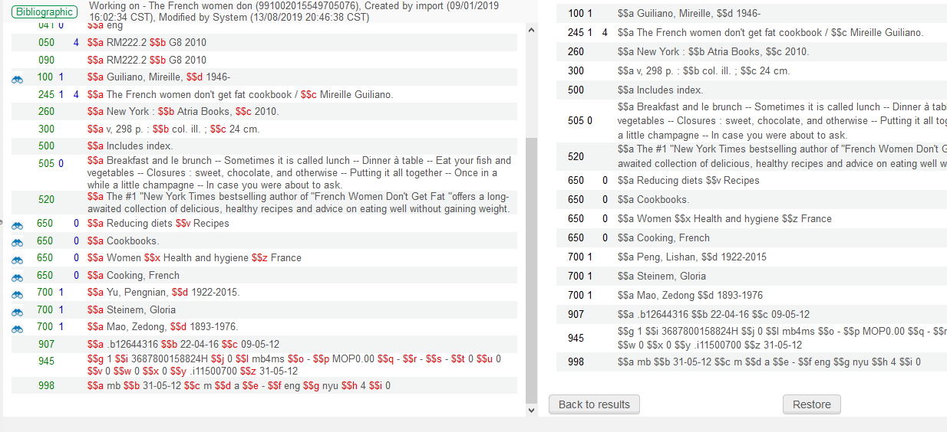
The results
Here is the change when doing "Tools > View Versions" in the Metadata Editor

Slide 26
Yoel.Kortick@exlibrisgroup.com

